Slide 1
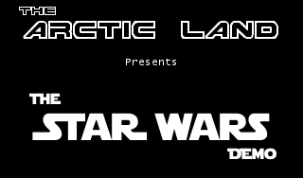
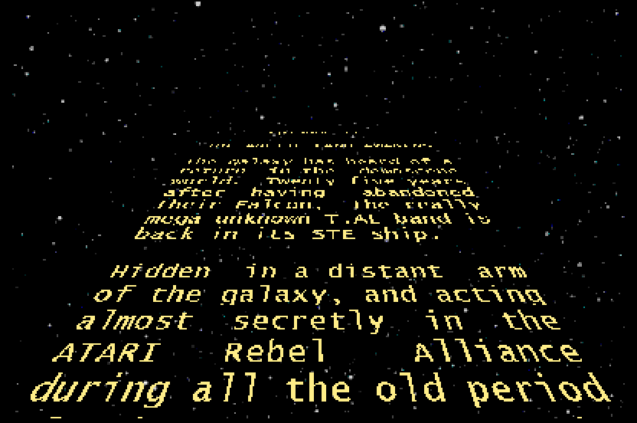

Disposition de titre
Sous-titre
crawl Making of

Slide 2

INTRODUCTION
Source code & this tutorial:
https://github.com/Uko-TAL/TheStarWarsDemo
Links:
https://www.pouet.net/prod.php?which=87771
https://demozoo.org/productions/289094/
ATARI STe demo by Uko from T.AL:
uko.tal@gmail.com
uko at www.atari-forum.com

Slide 3
Presentation Purpose
The name and theme of the demo come from one of the screens which is a scroller like the opening crawl of the movies
And I have received lots of nice comments about it, but also several requests to explain how this scroller is implemented
So here we are !

Slide 4
Design Constraints
Like all the screens of the demo, I wanted « breaking the limits » coding techniques: fullscreen, MOD music and lots of colours
Have the closest resemblance to the movie scroller:
Wide
Close 3D projection
Slow scrolling
Wide & fullscreen, means lots of pixels to update, but fullscreen also implies less CPU time
Slow implies aliasing flickering because of low resolution: play with projection parameters & font size to limit the effect

Slide 5
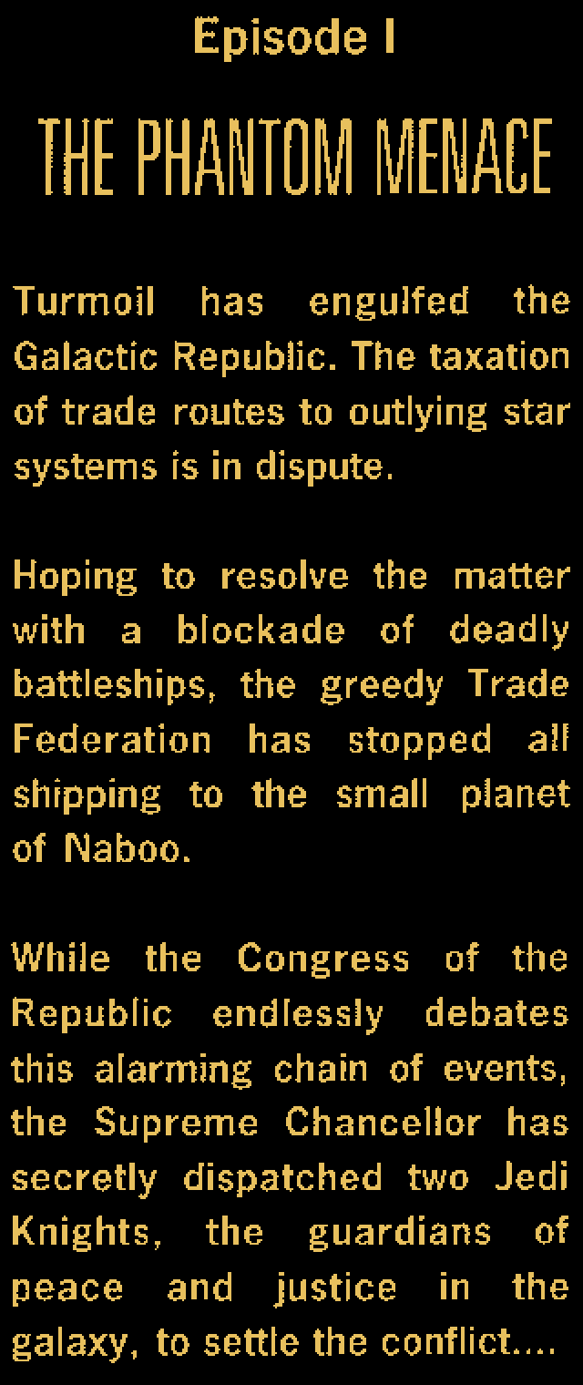

How does this work ?
A plane text area (I call it a “map”) at the bottom of the screen…
SC1224

Slide 6
How does this work ?
…is seen this way by simple 3D projection
SC1224

Slide 7
How does this work ?
Loop on each pixel of the relevant zone of the screen (do not loop on the map pixels !)….
SC1224

Slide 8
How does this work ?
…and launch a ray from the viewer’s eye thru the screen pixel…
SC1224

Slide 9
How does this work ?
…to find the pixel of the map that must be displayed !
SC1224

Slide 10
Do the maths ! (High school level ;))

Slide 11
Parameters
Eye X,Y,Z position
Screen W,H size
Map Wx,Wz size
Map Y,Z position

Slide 12
Prototype
Before coding in assembly, it is better to check the formulas are correct and test the parameters (mainly viewer position, and map size) to find the nicest projection
In the 90’s I would have used GFA Basic…
…instead I’ve used Python with Pygame on my PC laptop, and simulated a zoomed ST fullscreen resolution

Slide 13
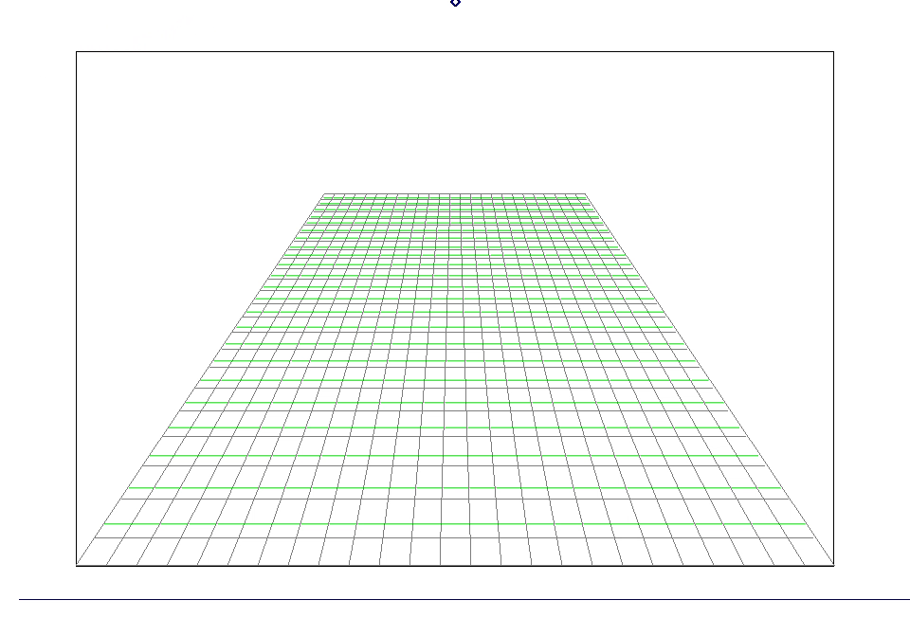
Play with parameters on wire-frame view

Slide 14
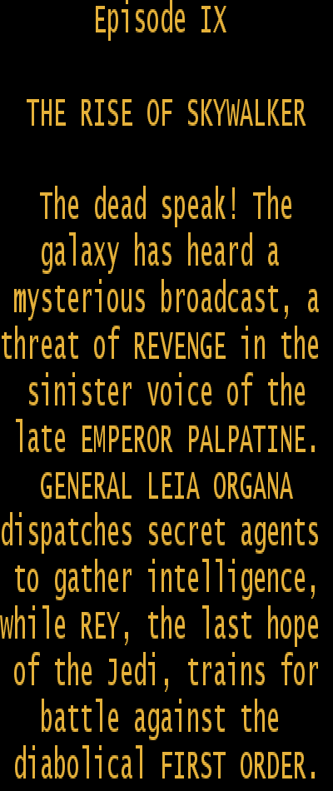
Now let’s map a bitmap

Slide 15
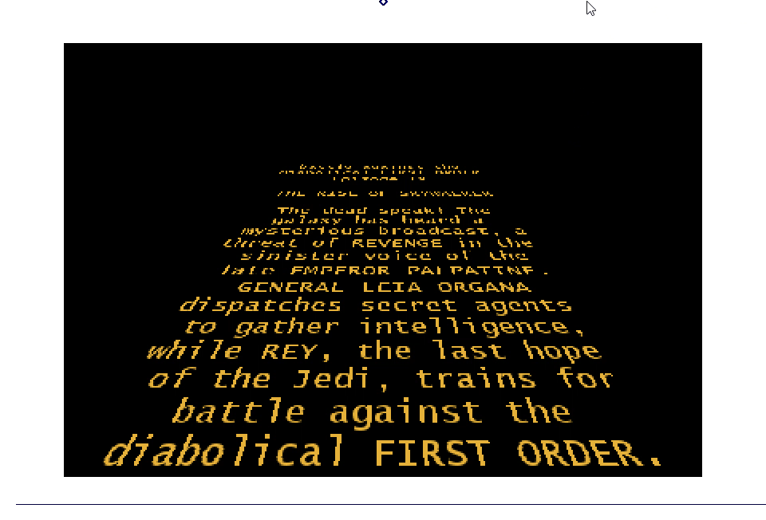
And play with mapping parameters

Slide 16

Then choose a font…
…and prototype the demo…

Slide 17
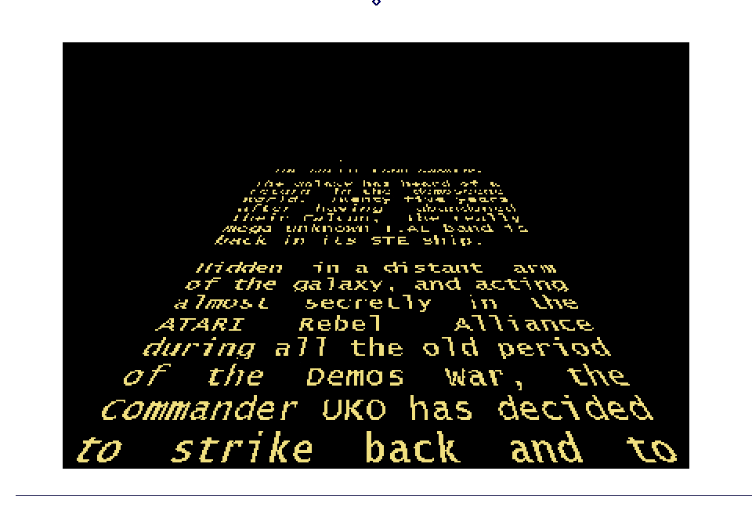
…and play again with different views !

Slide 18
And now ?
Take vasm, Devpac/MonST or Assemble/Adebug (Yes ! I love Adebug ! )
Do some precomputation for the maths part
…and after few hours of coding, you’ll get it !

Slide 19

This won’t work !!
Why ???
Not a falcon you have !
…???
Not powerful enough the STe is !
You think I’m a lamer ?
And no chunky mode you have !

Slide 20
Why is Yoda right ?

Slide 21
The facts #1
152
51 612 pixels
187
400

Slide 22
The facts #2
152
51 612 pixels
187
Cuddly demo ;-p
16 600 pixels
400

Slide 23
The facts #3
In fullscreen, if we let the non displayable part of the VBL for MOD playing and misc stuff, there are 360 cycles left between sync switches, and for 272 lines, so 97 920 CPU cycles left per VBL
The scroll step is slow, we only need to be at 25 Hz (but still in sync with VBL, using 2 VBL handlers), so we have 195 840 cycles left
… so 3.79 cycles to display each pixel… (for those with little memory, a NOP takes 4 cycles :-D)
And even in regrouping treatment in 16 pixels word, that’s not enough in planar mode

Slide 24
(My) Solution

Slide 25
Solution
Fortunately, this is not any bitmap we will use, but a text scroller
So composed of letters: in the demo 56 letters of 16x24 (incl SPACE)
So 25 “columns” of text

Slide 26
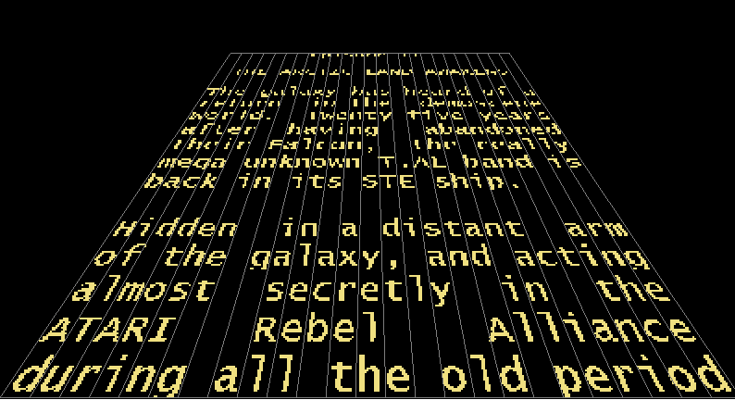
Solution

Slide 27
Solution
And for each letter and for each column/lane and for each Y pos in the lane…
.. we can precompute the 3D projection (incl. X shifting)
And use a move.l xx(a0), yy(a1) instruction for each line of each char in each lane (a0=precomputed font, a1=screen, xx=offset in the precomputed font, yy=offset in the screen)
So 28 cycles, to be repeated 25 (lanes) x 187 (lines) = 130 900 cycles, so less than the 195 840 cycles left

Slide 28

Solution
And except for the top lines where more than 2 columns fit in 16 pixels, we don’t even have to make an OR between columns using a bitplanes trick: in most cases, a letter of a column will have to be “split” onto two consecutive 16 pixels groups. We use a single Move.L to copy 1st part of the letter on bitplane 3 of the first 16 pixels group, then the 2nd part on bitplane 0 of next 16 pixels group. And we do the same for the next column.
This only limits the background stars to 4 colors (per line)
Bitplane | 0 | 1 | 2 | 3 | 0 | 1 | 2 | 3
Pixels | 0-15 |  |  |  | 16-31

Slide 29
Solution
This requires some memory for precomputed font data
4 bytes x 24 lines per char x 56 chars x 187 lines of scroller x 25 columns = 25 MBytes
Being smarter, using columns varying width, and reusing some common precomputation will nevertheless require close to 5 MBytes
Ooops….

Slide 30
Solution
But if we take the approximation that the projection for all columns is the same (not true, but visually acceptable) with different X positions for each line, we resume the problem to having different char sizes, and this leads to 12 different char sizes (width reduction only)
4 bytes x 24 lines per char x 56 chars x 12 char sizes x 15 X-shifts = 967 KBytes
Definitively acceptable nowadays, but I like the idea that each screen could independently run on a stock 512 KBytes STe (without MOD music, …)

Slide 31
Uko strikes back

Slide 32
Solution #2
Letters have a lot of common lines !
Within a same letter
And between letters !
For the 56 letters, there are only 188 different lines ! (among 56 x 24 = 1344 lines)

Slide 33
Solution #2
4 bytes x 188 lines x 12 char sizes x 15 X-shifts = 135 KBytes
We just need an indirection for each char to get the correct line
And we will use a scrolling buffer before projection where we will store this indirection for each char instead of the char bitmap

Slide 34
Solution #2
The code is now for each line of each char in each lane (a0= scroll text buffer, a1=precomputed line patterns, a2=screen)
move.l (a0)+,a1 ; 12
move.l xx(a1),yy(a2) ; 28
So 40 cycles, to be repeated 25 (lanes) * 187 (lines) = 187 000 cycles, so still less than the 195 840 cycles left !

Slide 35
Solution #2
Now write a little program to generate the projection code (unless you want to manually write all the xx and yy offsets in the move.l xx(a1),yy(a2) lines)
Split the code into 360 cycles slices (to be inserted between fullscreen switches)
Don’t forget to manage the top lines where more than 2 columns fit in 16 pixels

Slide 36
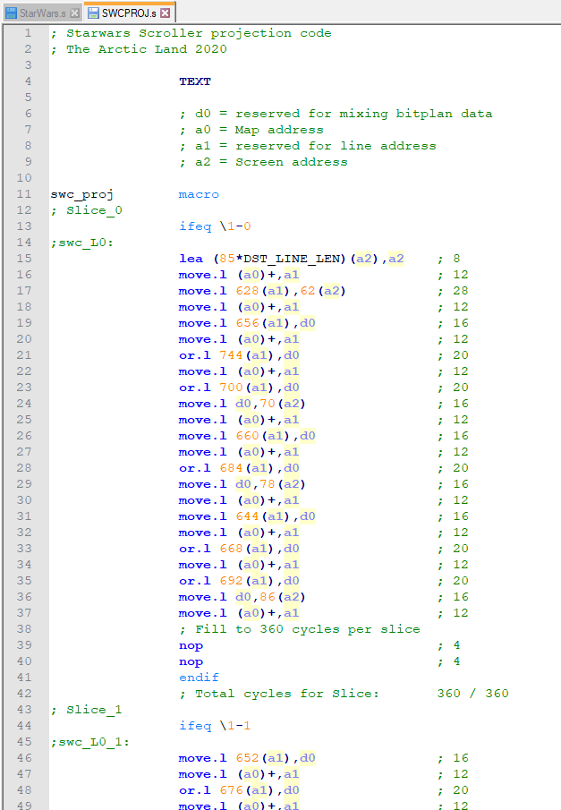
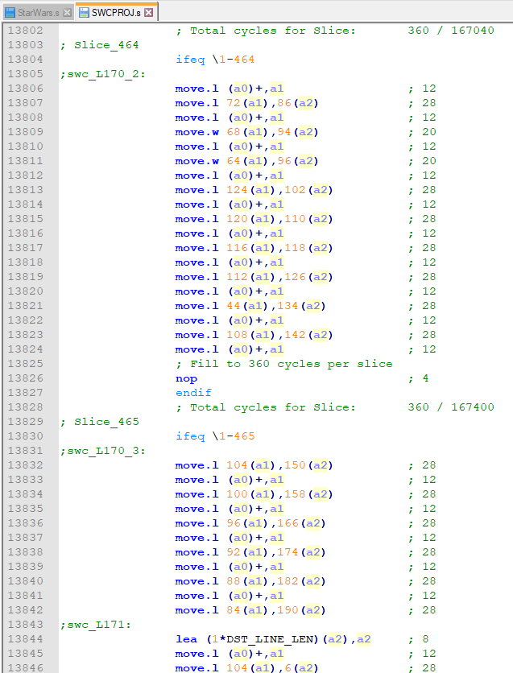
Solution #2

Slide 37
